Slide 1
Object Oriented Programming with Java
Day 8

Slide 2
Learning About the Concept of Inheritance
Inheritance
A mechanism that enables one class to inherit both the behavior and the attributes of another class
Apply your knowledge of a general category to more specific objects

Slide 3
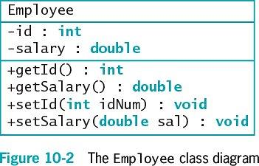
Diagramming Inheritance Using the UML
Unified Modeling Language (UML)
Consists of many types of diagrams
Class diagram
A visual tool
Provides an overview of a class

Slide 4
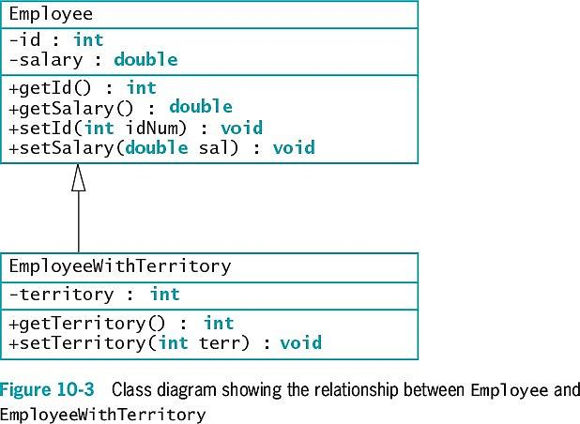
Diagramming Inheritance Using the UML

Slide 5
Diagramming Inheritance Using the UML
Use inheritance to create a derived class
Saves time
Reduces errors
Reduces the amount of new learning required to use a new class

Slide 6
Inheritance Terminology
Base class
Used as a basis for inheritance
Also called:
Superclass
Parent class
Derived class
Inherits from a base class
Always “is a” case or an example of a more general base class
Also called:
Subclass
Child class

Slide 7
Extending Classes
Keyword extends
Used to achieve inheritance in Java
Example:
public class EmployeeWithTerritory extends Employee
Inheritance is a one-way proposition
A child inherits from a parent, not the other way around
Subclasses are more specific
instanceof operator

Slide 8
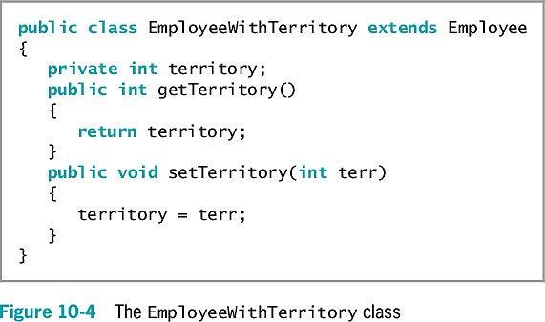
Extending Classes

Slide 9
Overriding Superclass Methods
Create a subclass by extending an existing class
A subclass contains data and methods defined in the original superclass
Sometimes superclass data fields and methods are not entirely appropriate for subclass objects
Polymorphism
The same method name is used to indicate different implementations

Slide 10
Overriding Superclass Methods
Override the method in the parent class
Create a method in a child class that has the same name and parameter list as a method in its parent class
Subtype polymorphism
The ability of one method name to work appropriately for different subclass objects of the same parent class
Override annotation (@Override)
Tells compiler you are overriding a parent class method

Slide 11
Calling Constructors During Inheritance
When you instantiate an object that is a member of a subclass, you call at least two constructors:
The constructor for the base class
The constructor for the extended class
The superclass constructor must execute first
When the superclass contains a default constructor, the execution of the superclass constructor is transparent

Slide 12
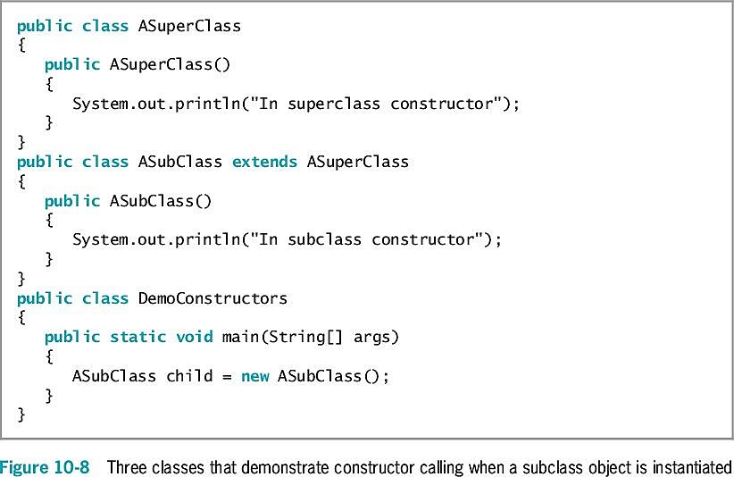
Calling Constructors During Inheritance
What will this program print out when you run the DemoConstructors class?

Slide 13
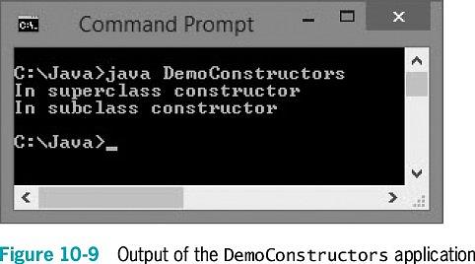
Calling Constructors During Inheritance

Slide 14
Using Superclass Constructors That Require Arguments
When you write your own constructor
You replace the automatically supplied version
When extending a superclass with constructors that require arguments
The subclass must provide the superclass constructor with the arguments it needs

Slide 15
Using Superclass Constructors That Require Arguments
When a superclass has a default constructor
You can create a subclass with or without its own constructor
When a superclass contains only constructors that require arguments
You must include at least one constructor for each subclass you create
The first statement within each constructor must call one of the superclass constructors

Slide 16
Using Superclass Constructors That Require Arguments
Call the superclass constructor
super(list of arguments);
Keyword super
Always refers to the superclass

Slide 17
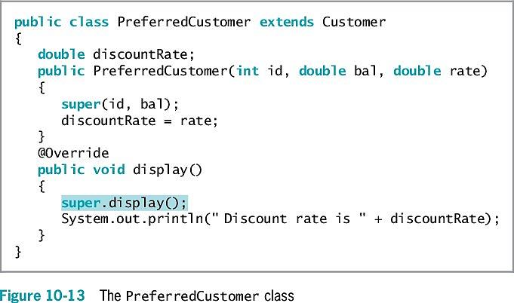
Accessing Superclass Methods
Use the overridden superclass method within a subclass
Use the keyword super to access the parent class method

Slide 18
Comparing this and super
Think of the keyword this as the opposite of super within a subclass
When a parent class contains a method that is not overridden
The child can use the method name with super or this, or alone

Slide 19
Exercise
Prior to developing this program, read the requirements and draw a class diagram of the classes you intend to build.
Mick’s Wicks makes candles in various sizes. Create a class for the business named “Candle” that contains data fields for color, height and price. Create get methods for all three fields. Create set methods for color and height, but not for price. Instead, when height is set, determine the price as $2 per inch.
Create a child class named ScentedCandle that contains an additional data field named scent and methods to get and set it. In the child class, override the parent’s setHeight() method to set the price of a ScentedCandle object at $3 per inch.
Write an application that instantiates an object of each type and displays the details.
Run the program to test the results.
Notes:
Ask a student to draw his/her diagram on the whiteboard.

Slide 20
Encapsulation
Within the Student class:
The keyword private precedes each data field
The keyword public precedes each method
Information hiding
The concept of keeping data private
Data can be altered only by methods you choose and only in ways that you can control

Slide 21
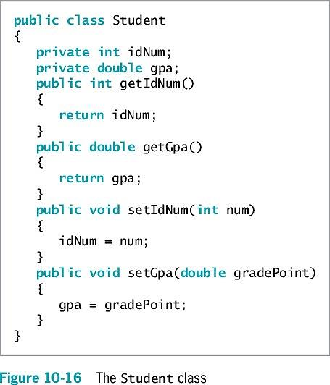
Employing Information Hiding
When a class serves as a superclass
Subclasses inherit all data and methods of the superclass
Except private members of the parent class are not accessible within a child class’s methods

Slide 22
Employing Information Hiding
Keyword protected
Provides an intermediate level of security between public and private access
Can be used within its own class or in any classes extended from that class
Cannot be used by “outside” classes

Slide 23
Methods You Cannot Override
static methods
final methods
Methods within final classes

Slide 24
A Subclass Cannot Override static Methods in Its Superclass
A subclass cannot override methods declared static in the superclass
A subclass can hide a static method in the superclass by declaring a static method with the same signature as the static method in the superclass
Then call the new static method from within the subclass or in another class by using a subclass object
Within the static method of a subclass, you cannot access the parent method using the super object

Slide 25
A Subclass Cannot Override static Methods in Its Superclass
Although a child class cannot inherit its parent’s static methods, it can access its parent’s static methods in the same way any other class can

Slide 26
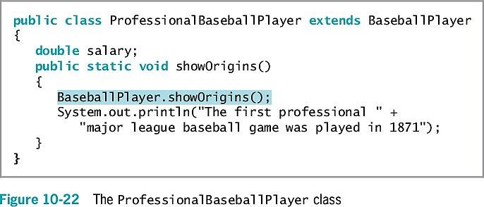
A Subclass Cannot Override static Methods in Its Superclass

Slide 27
A Subclass Cannot Override final Methods in Its Superclass
A subclass cannot override methods declared final in the superclass
final modifier
Does not allow the method to be overridden
Virtual method calls
Default in Java
The method used is determined when the program runs
The object type might not be known until the method executes

Slide 28
A Subclass Cannot Override final Methods in Its Superclass
Advantages to making the method final:
The compiler knows only one version of the method exists
The compiler knows which method version will be used
A program’s performance can be optimized by removing calls to final methods
Inlining the code: each method call is replaced with the expanded code of the method’s definition

Slide 29
A Subclass Cannot Override Methods in a final Superclass
When a class is declared final:
All of its methods are final regardless of which access modifier precedes the method name
It cannot be a parent class

Slide 30
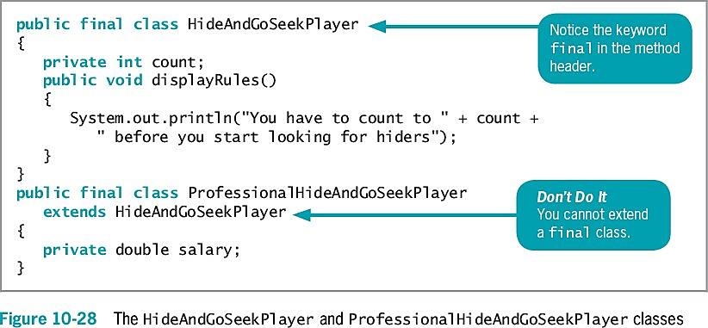
A Subclass Cannot Override Methods in a final Superclass

Slide 31
Don’t Do It
Don’t capitalize the o in the instanceof operator
Don’t try to directly access private superclass members from a subclass
Don’t forget to call a superclass constructor from within a subclass constructor if the superclass does not contain a default constructor
Don’t try to override a final method in an extended class
Don’t try to extend a final class

Slide 32
Summary
Inheritance
A mechanism that enables one class to inherit both the behavior and the attributes of another class
Keyword extends
Used to achieve inheritance in Java
Polymorphism
The act of using the same method name to indicate different implementations
Use a superclass method within a subclass
Use the keyword super to access it
Encapsulation
The concept of keeping data private
Keyword protected
Provides an intermediate level of security between public and private access
A subclass cannot override methods that are:
Declared static in a superclass
Declared final or declared within a final class

Slide 33
Quiz
Which of the following choices is the best example of a parent class/child class relationship? Explain your answer.
Rose/Flower
Present/Gift
Dog/Poodle
Sparrow/Bird
Which Java keyword creates inheritance?
If the only constructor in a superclass requires arguments, its subclass ___. Explain your answer.
Must contain a constructor
Must not contain a constructor
Must contain a constructor that requires arguments
Must not contain a constructor that requires arguments.
Within a subclass, you can not override ___ methods. Explain your answer.
Public
Private
Static
Constructor

Slide 34
Exercise
Prior to developing this program, read the requirements and draw a class diagram of the classes you intend to build.
Create a class named CollegeCourse that includes data fields that hold the department (e.g. ENG), the course number (e.g. 101), the credits (e.g. 3) and the fee for the course (e.g. $360). All of the fields are required as arguments to the constructor, except for the fee, which is calculated at $120 per credit hour. Include a display() method that displays the course data.
Create a subclass named LabCourse that adds $50 to the course fee. Override the parent class display() method to indicate that the course is a lab course and to display all the data.
Write an application named UseCourse that prompts the user for course information. If the user enters a class in any of the following departments, create a LabCourse: BIO, CHM, CIS or PHY. If the user enters any other department, create a CollegeCourse that does not include the lab fee. Then display the course data.
Run the program to test the results.

